Slide 1
GWAS of Tongue Rolling
Shivang Sharma, Jason Chang, Ryan Zhao
2023.04.26

Slide 2

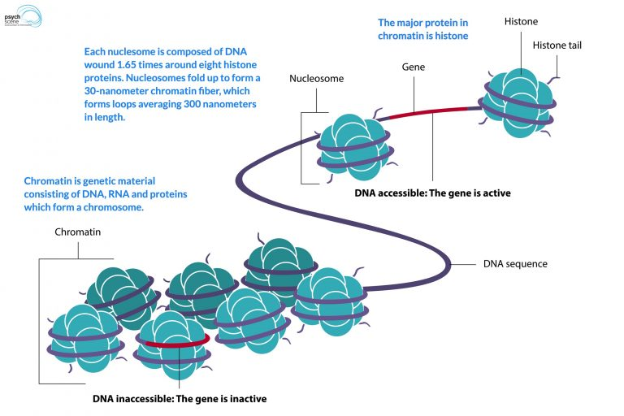
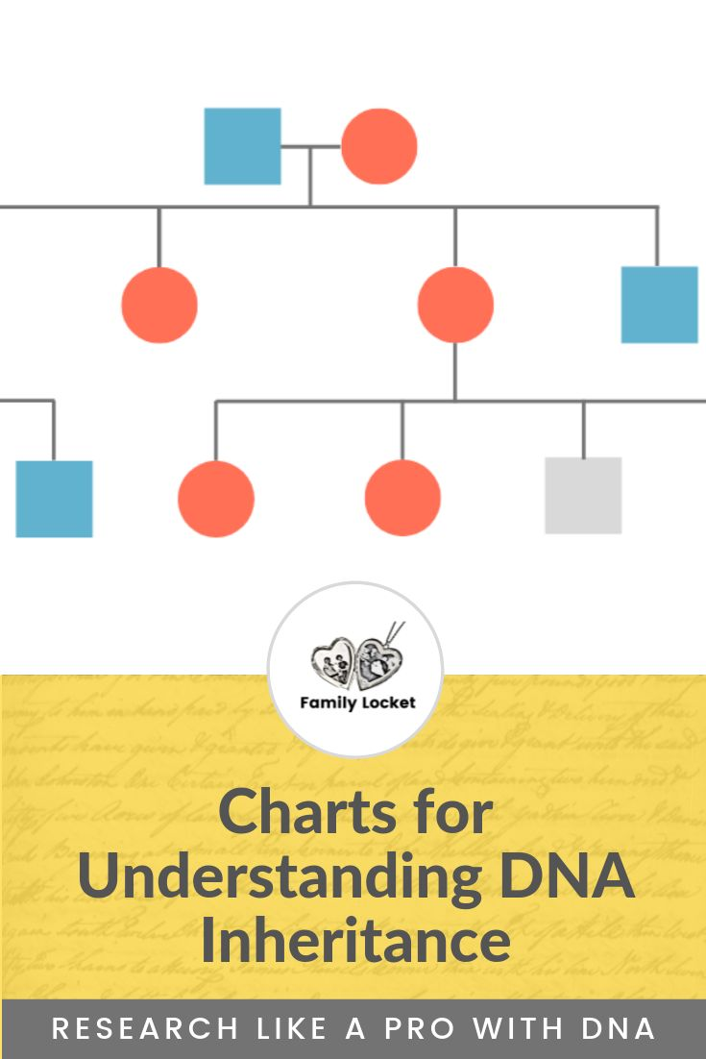
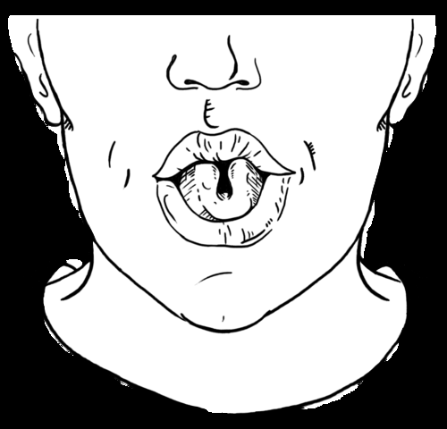

Selected Trait: Tongue Rolling
Description
Genetics
Epigenetics
Importance
Ability to roll tongue into U shape
65 - 81% population can roll tongue
Genetics seems to be partially responsible
- Parents with the trait have have chances of offsprings with similar trait
Genetics is not solely responsible for the trait
- Identical twins can also have both dominant and recessive traits
Due to the functional and cosmetic insignificance of this trait, it can be easily reported without causing any discrimination
Source: Myths of Human Genetics: Tongue Rolling (udel.edu)

Slide 3
Workflow
Data Wrangling
GWAS
Machine Learning
Data collection
Cleaning
Integration
Quality control
Population Stratification
Association analysis
Output transformation
Unsupervised learning
Supervised learning
Hyperparameter Tuning
Feature Importance

Slide 4
Data wrangling
433 samples
Final data integration into binary format acceptable by PLINK (~20% non-rollers and ~80% rollers)
5
Remove SNPs flagged as triallelic during integration
4
Check for corrupted/duplicated files with GRCh37 build
3
Simplify phenotypic data
2
Identify and download 23andme files for samples with trait reported
1
> 700 samples

Slide 5
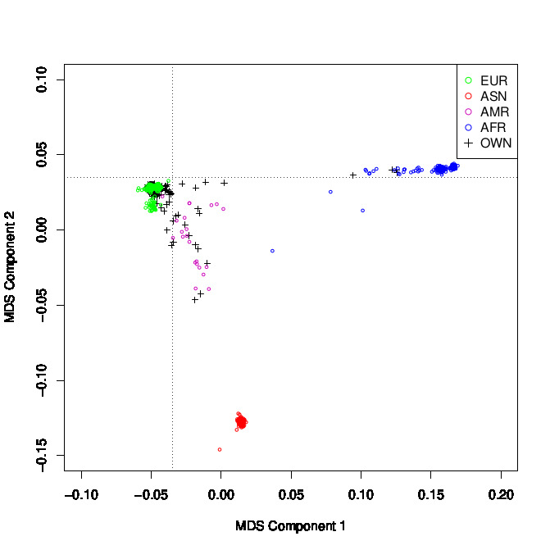
Genome Wide Association Study
Quality Control
Population stratification
Association study
- 433 samples (75 non-rollers (cases), 358 rollers (controls)
- Gender information was imputed and the cohort wasn’t segregated for gender
- MAF: 0.05
- Total of 3 individuals had cryptic relatedness
- 348 samples (~20% cases) used for step 2
- No statistically significant SNPs were obtained after adjustment
- SNPs with p-value < 0.01 before adjustment were selected to perform unsupervised clustering
- Approx 3860 SNPs were obtained after filtering
~99% samples

Slide 6
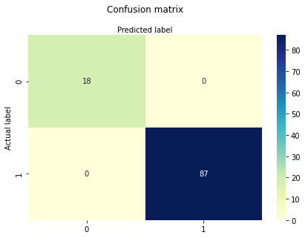
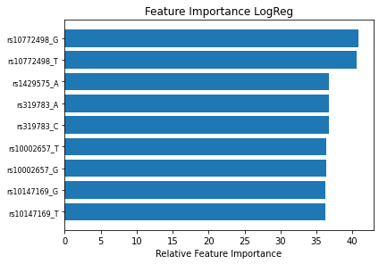
Logistic Regression

Slide 7
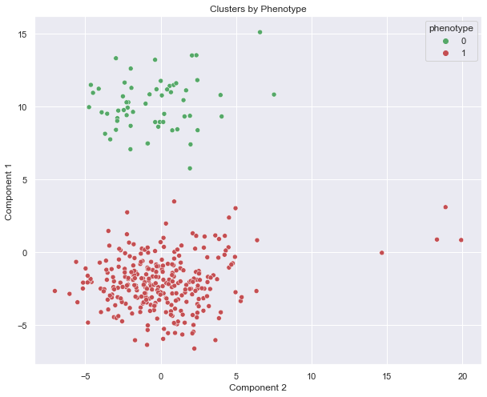
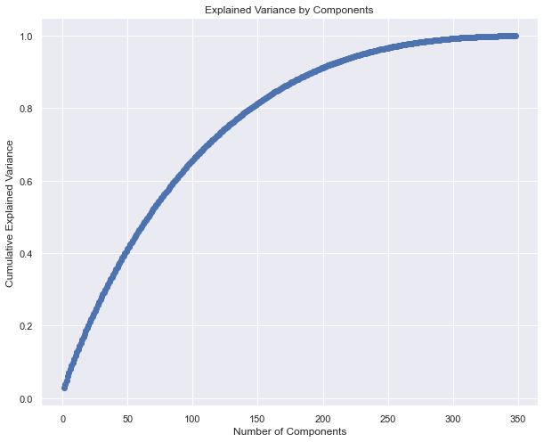
Primary Component Analysis

Slide 8
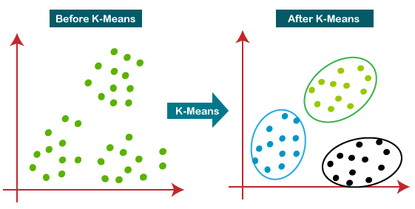
K-Means

Slide 9
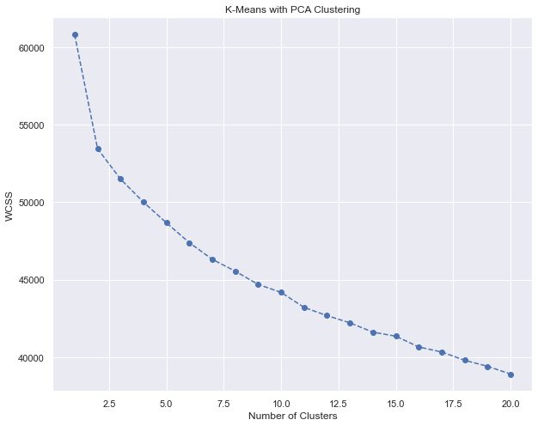
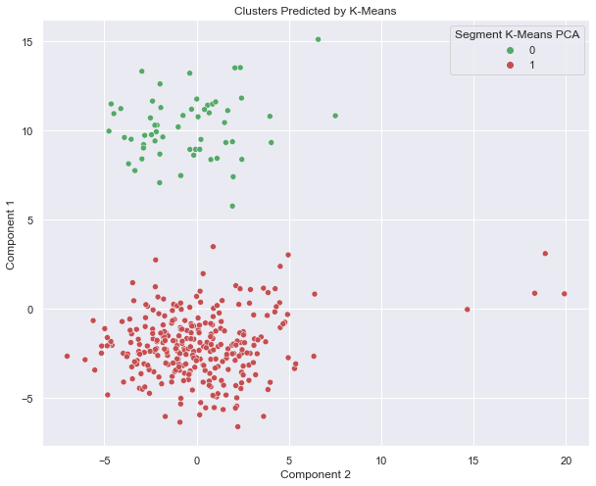
K-Means Clustering
Suggested # of clusters: 2

Slide 10
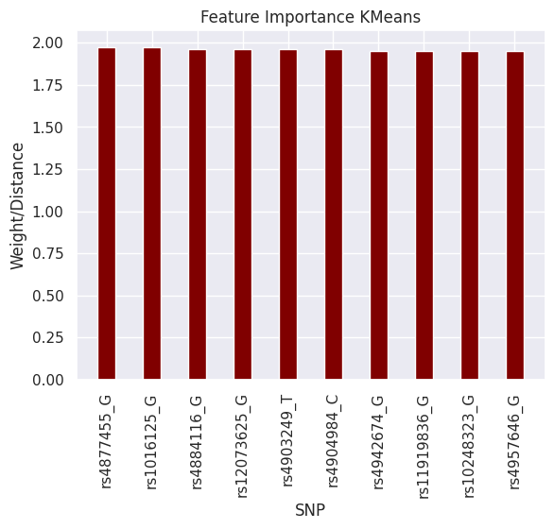
Feature Importance K-Means

Slide 11
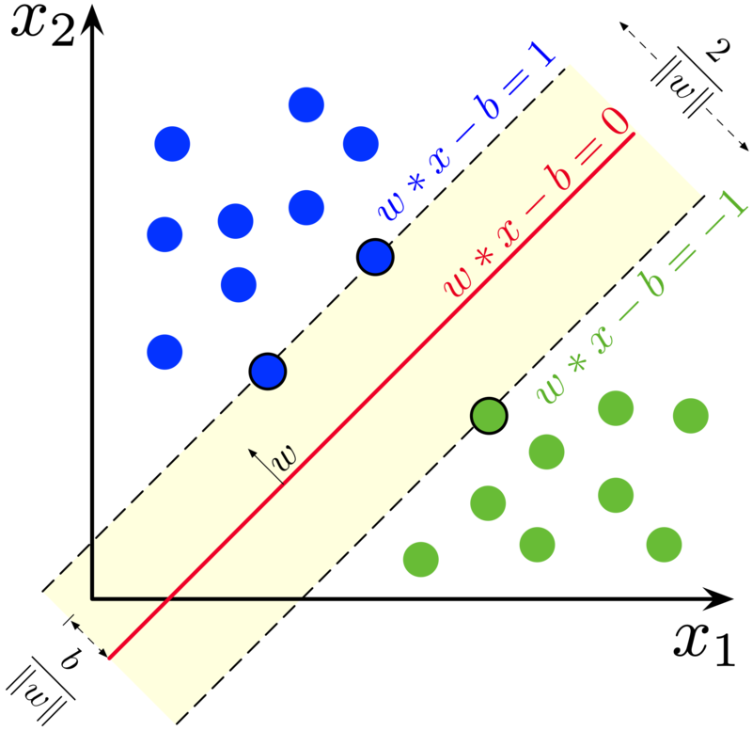
Support Vector Classifier (SVC)
https://en.wikipedia.org/wiki/Support_vector_machine#/media/File:SVM_margin.png

Slide 12
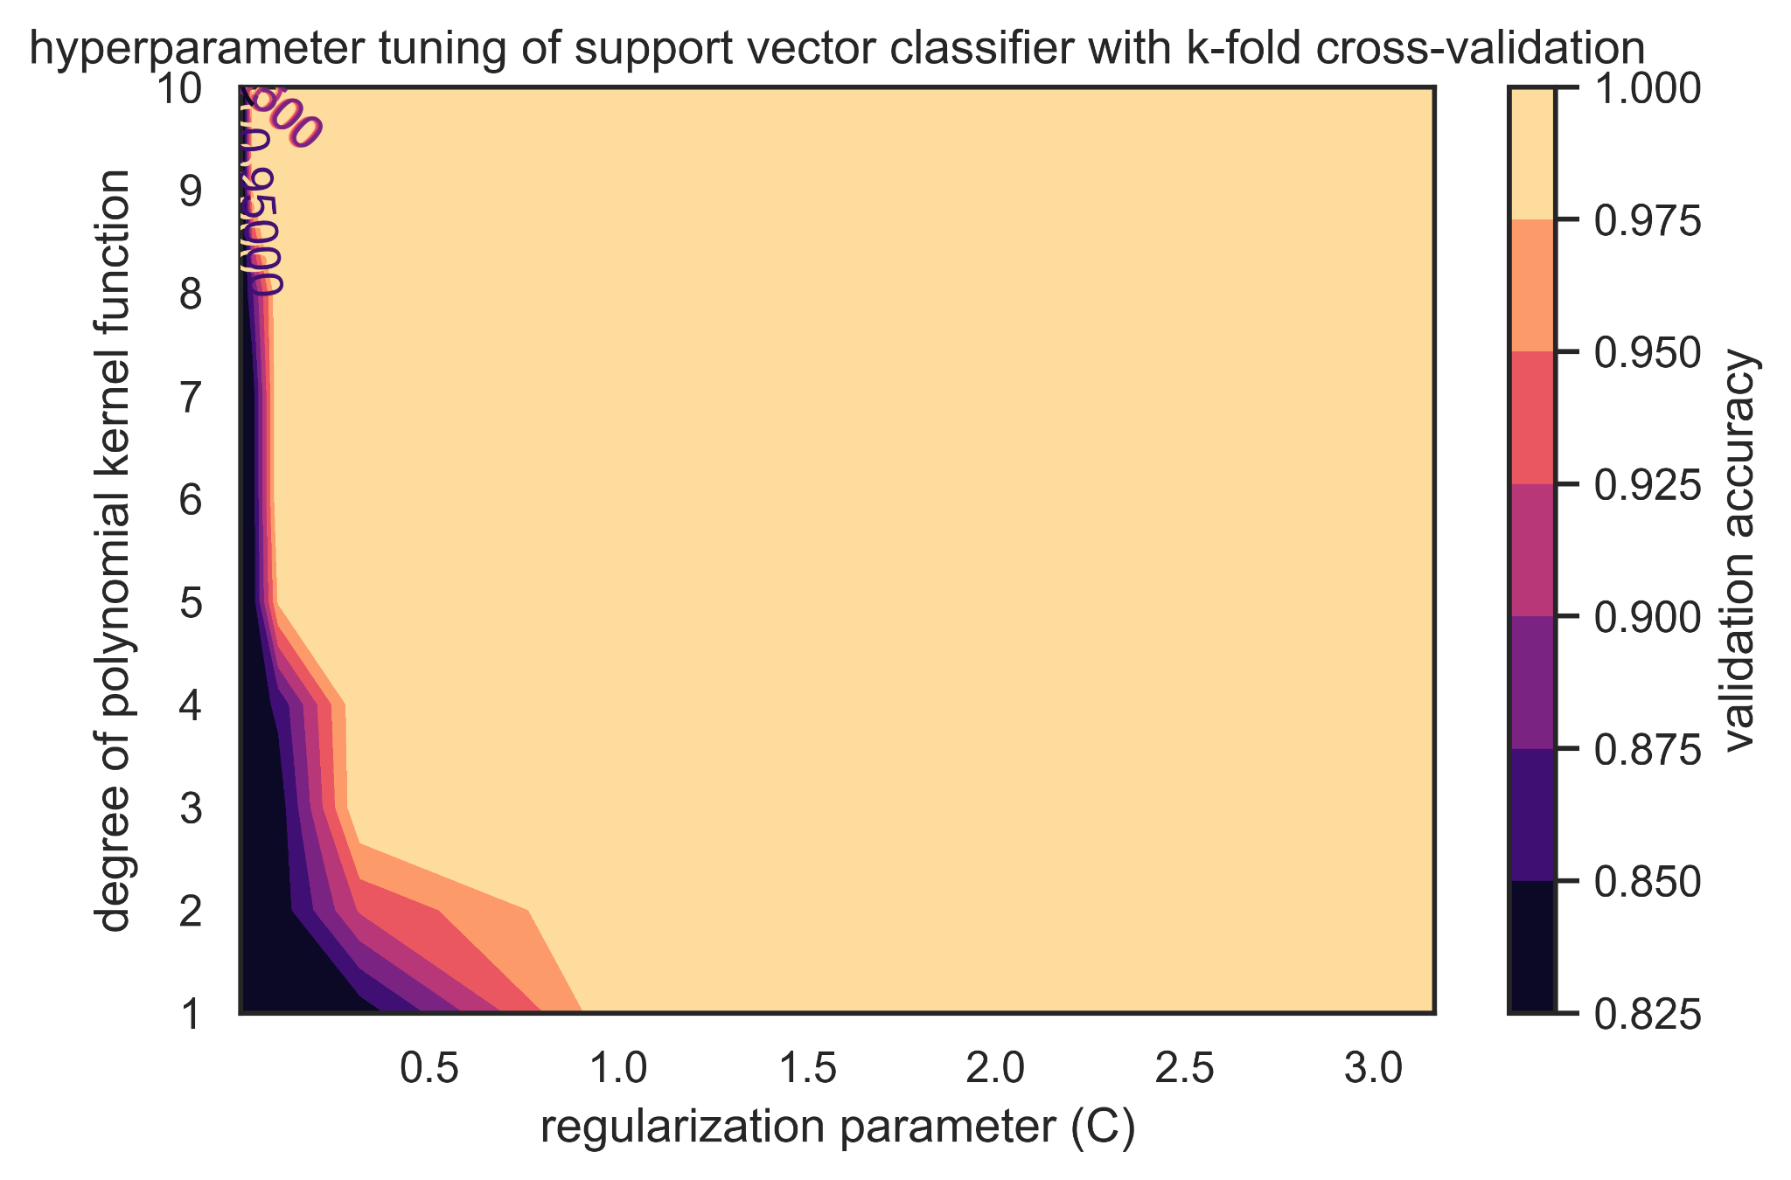
SVC Hyperparameter Tuning
Optimal C: 0.1
Optimal degree of polynomial kernel: 7
Optimal accuracy: 100%

Slide 13
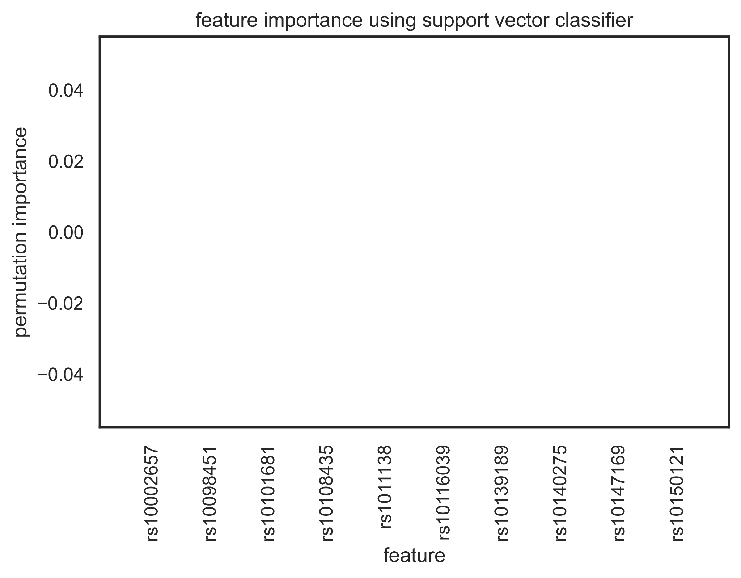
SVC Permutation Feature Importance

Slide 14
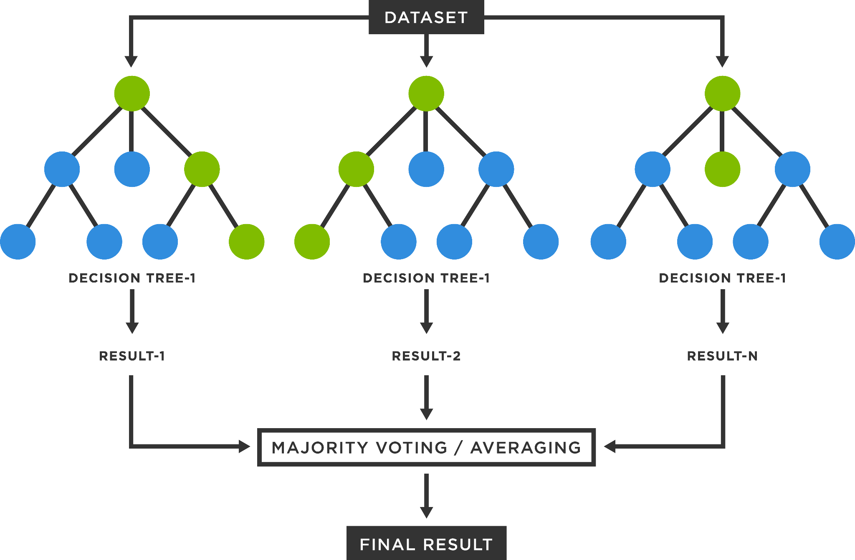
Random Forest Classifier (RFC)
https://www.tibco.com/reference-center/what-is-a-random-forest

Slide 15
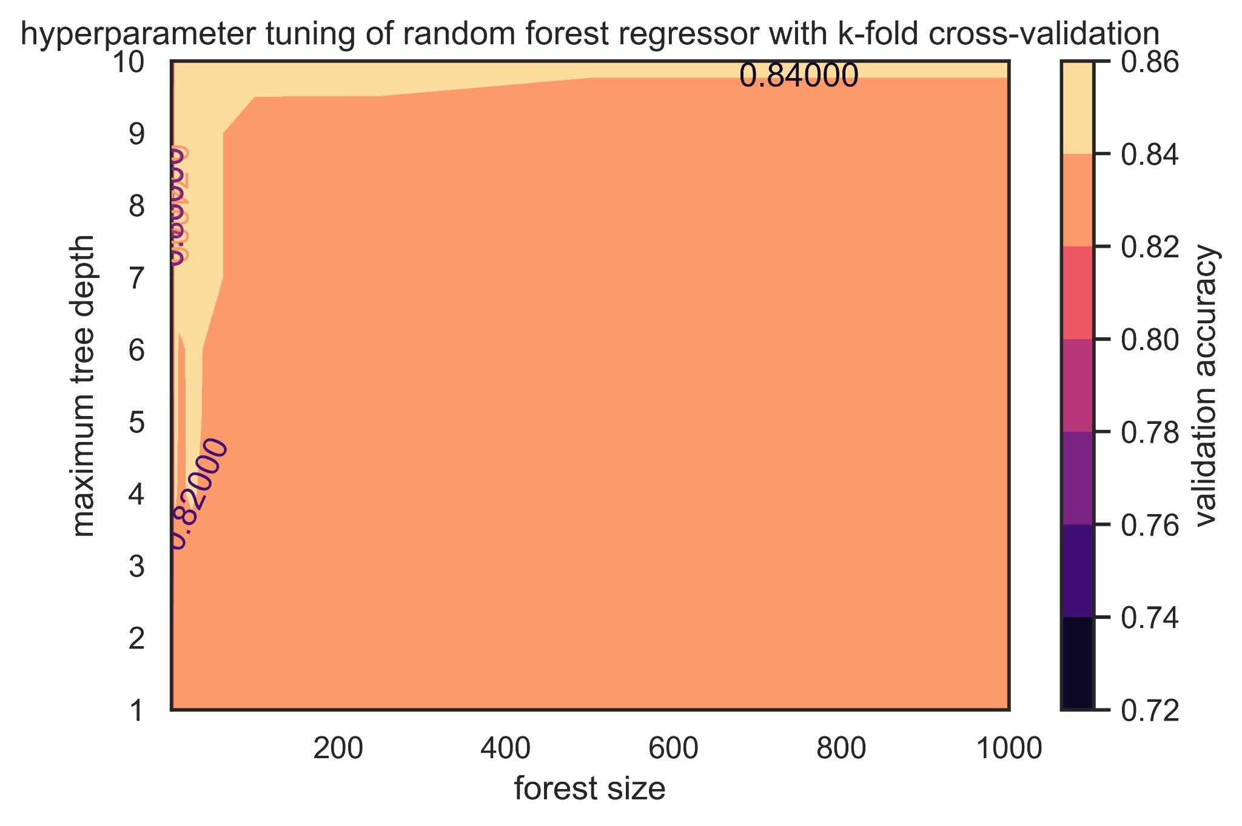
RFC Hyperparameter Tuning
Optimal forest size: 25
Optimal max tree depth: 9
Optimal accuracy: 85.98%

Slide 16
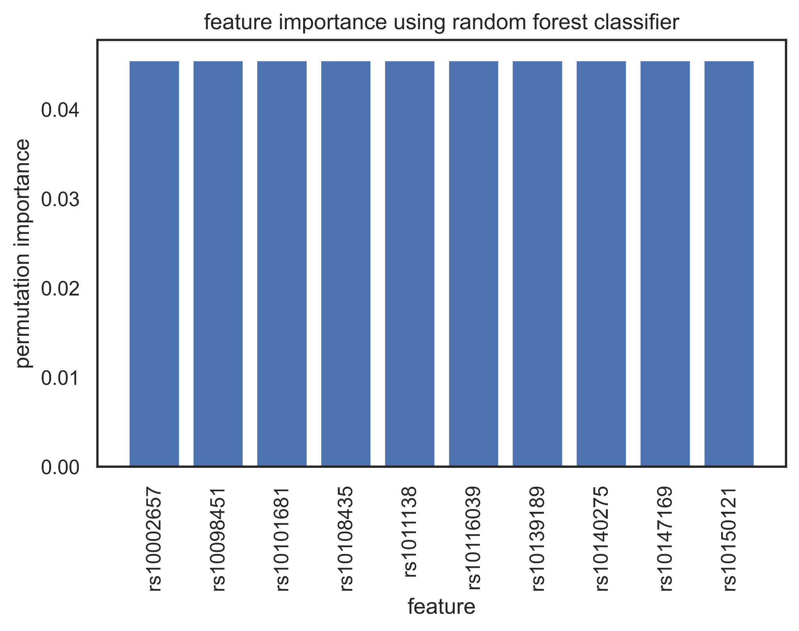
RFC Permutation Feature Importance

Slide 17
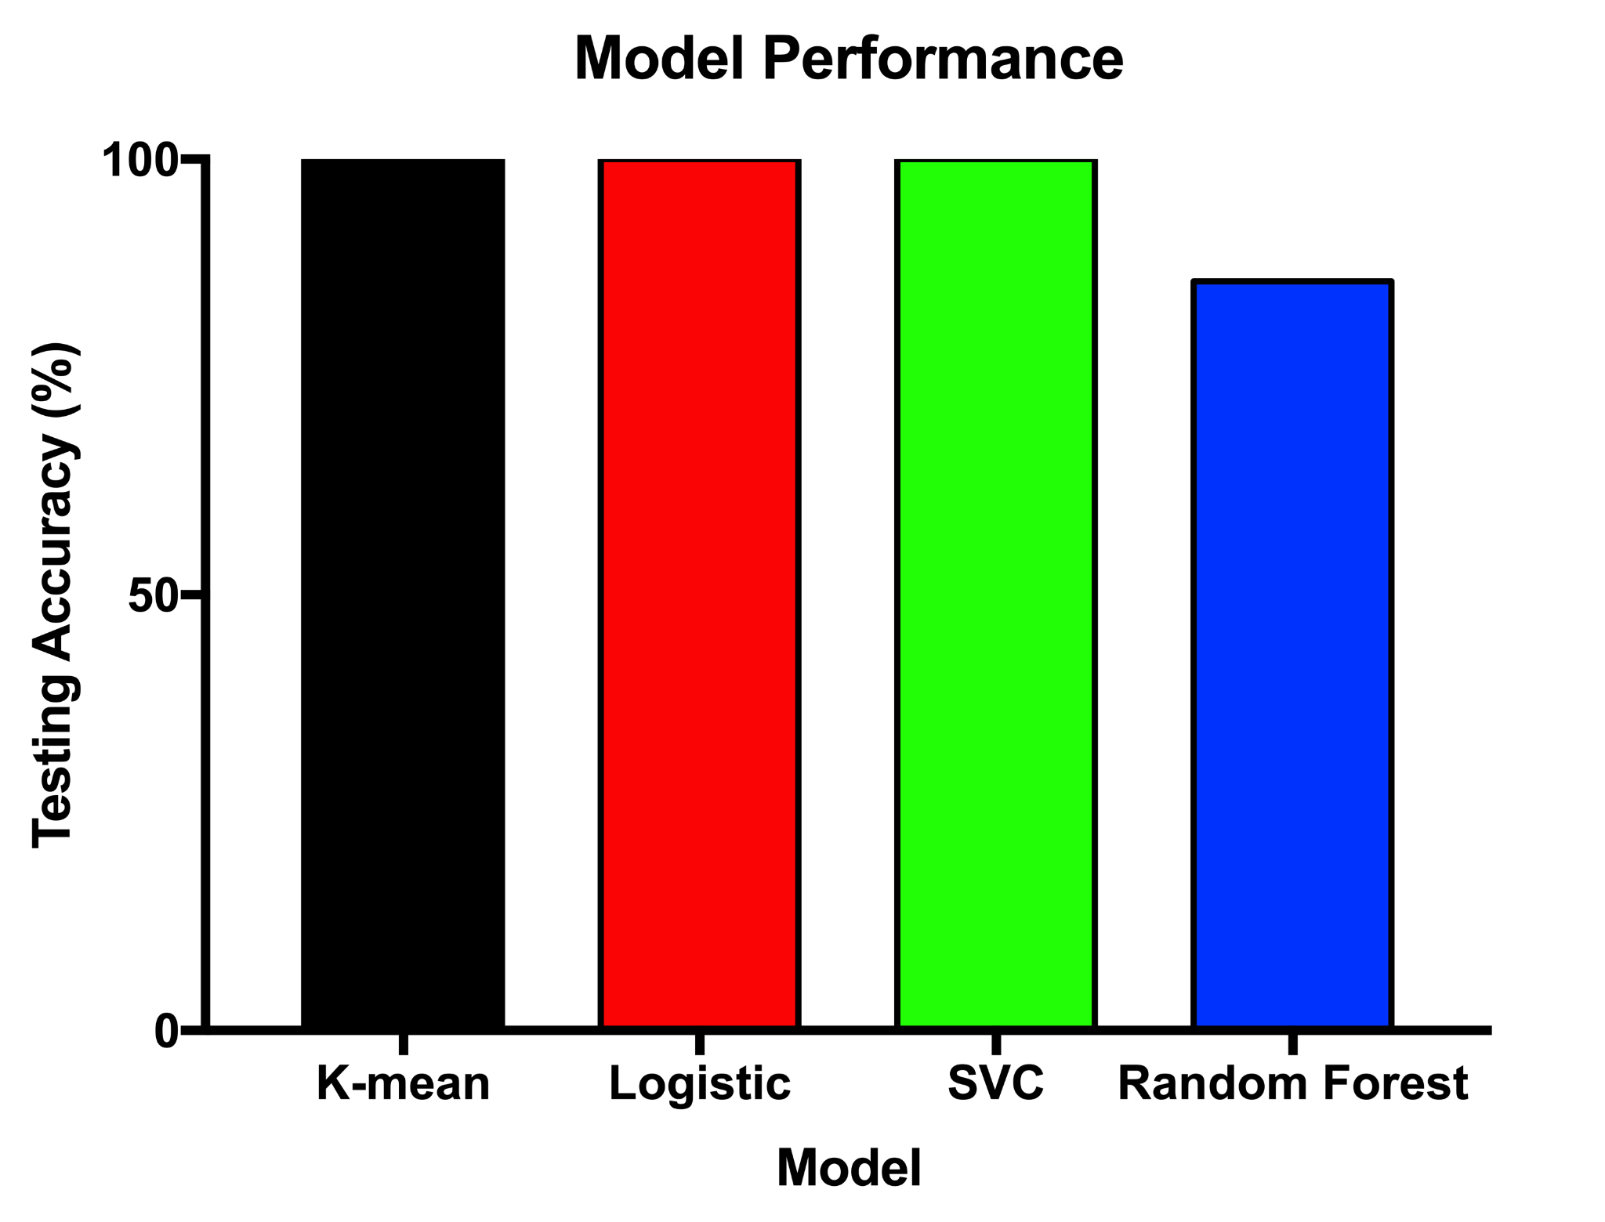
Evaluating Model Performance

Slide 18
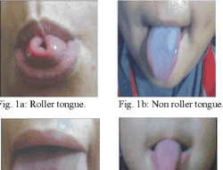
Conclusion
Feature importance suggests that genes encoding for tongue rolling are spread out across multiple genes
With current SNP dataset, we can accurately predict tongue rollers vs. non-tongue rollers
Next Steps:
Test feature importance with other models
Recover missing (possibly insignificant SNPs) to run models with comprehensive dataset
Correlation matrix to detect LD blocks

Slide 19
Scope of improvements
Dataset size could be increased to obtain better hypotheses
Possibly decrease threshold to include a larger # of SNPs
SNPs flagged triallelic, SNPs observed at multiple locations and reducing disagreements by flipping the flagged SNPs can be implemented to retain more SNPs for association analysis
Repeat with other classification methods (e.g. Spectral clustering) which are less dependent on the dimensionality of the dataset

Slide 20

Acknowledgements
- Dr. Rachel Karchin
- Jessica Lin
- Fellow classmates

